Slide 1

The Path to Compliance!
Anglia Ruskin University

Slide 2


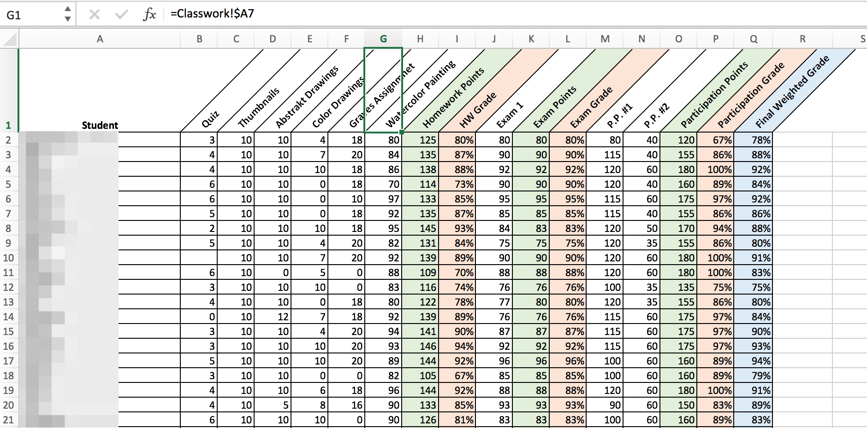
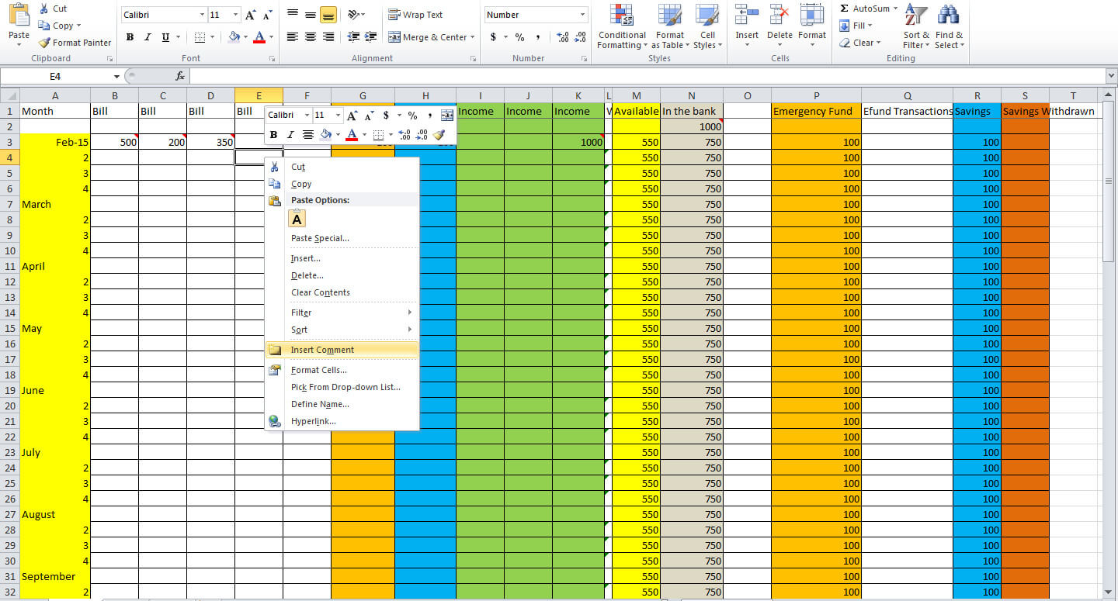

Starting Point!
This Photo by Unknown Author is licensed under CC BY-NC-ND

Slide 3
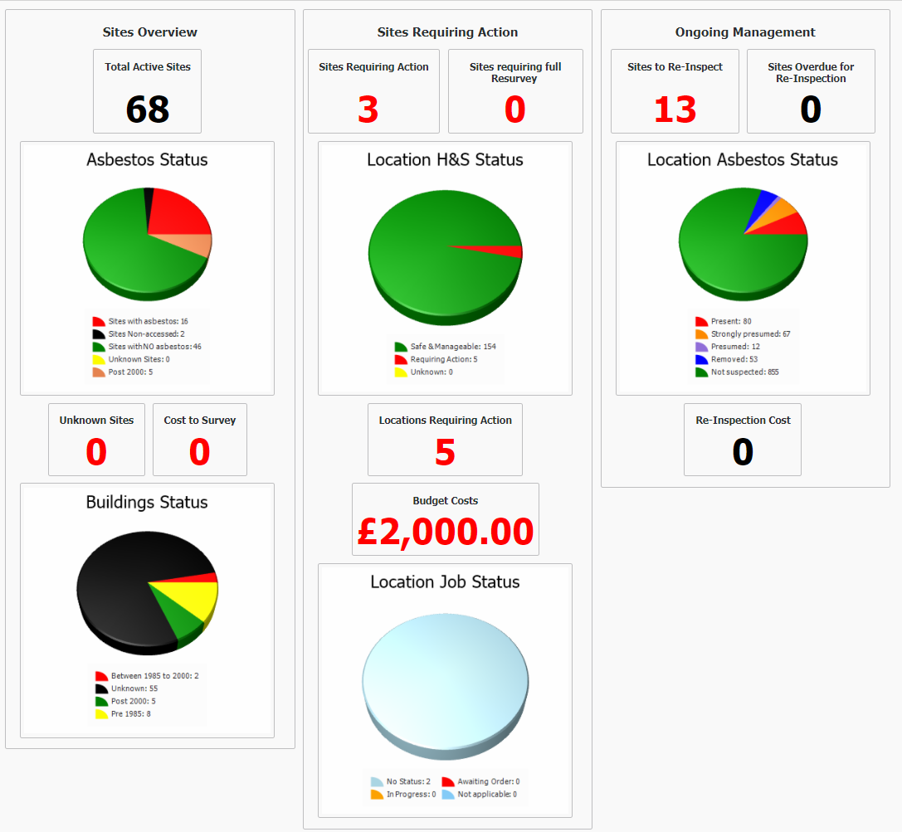
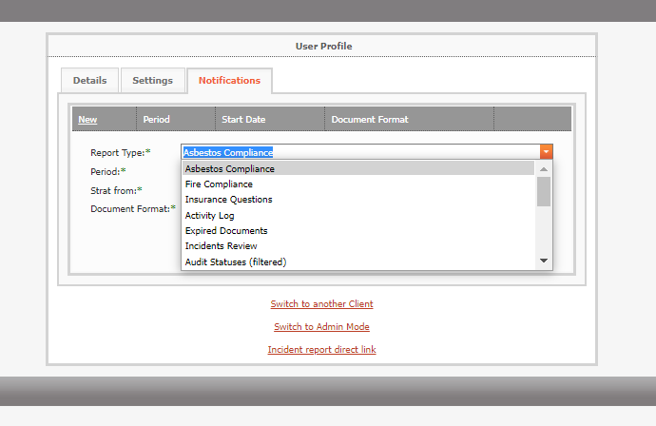
What Does End Goal Look Like?

Slide 4
Human beings are far smarter than computers!
- Steve Aldridge

Slide 5
First Floor
FIRST FLOOR first floor
First.Floor
First-Floor
Fst Floor
01 Floor
01
01 F/Flr
01 First Floor
How many First Floors are there?

Slide 6
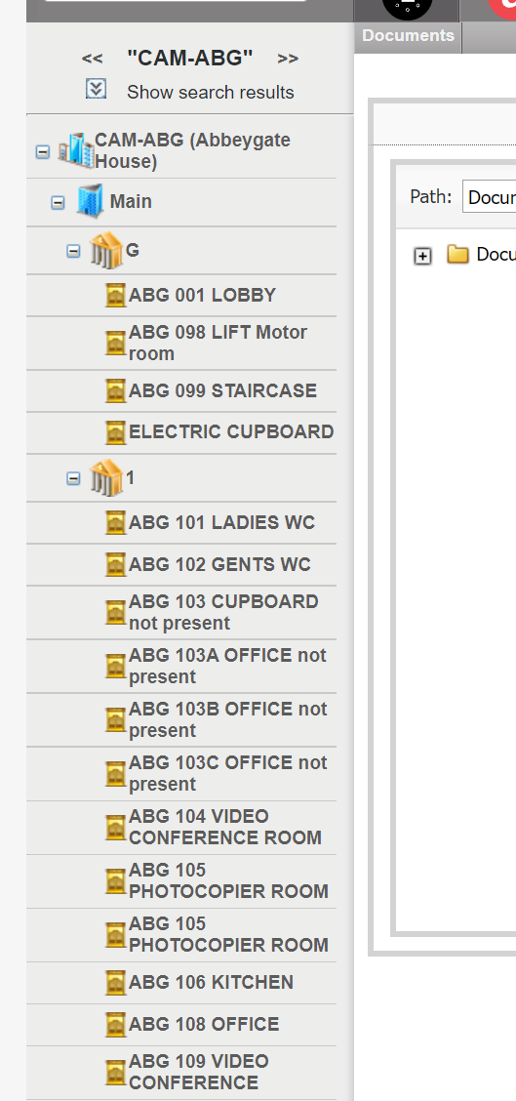

Slide 7
What Did The End Goal Look Like?

Slide 8

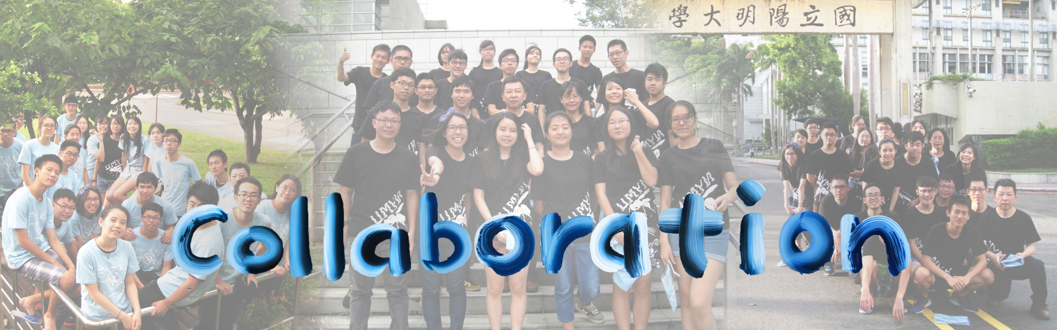
What Did The End Goal Look Like?

Slide 9
Challenges!
Data Consolidation.
Differing Requirements.
Buy In, Internal & External.
Handling Change.
Cost.

Slide 10
Tips
Keep as close as possible to existing processes.
Keep it simple.
Configure software to fit process

