Slide 1
NEDeRS®
National Equipment Defect Reporting System
Overview of the web based scheme
Notes:
Tonight’s conference dinner will be at the Mansion House (the stately building across the lawn from this one), courtesy of Scottish and Southern Energy. Details of how to get there are in your pack. Many thanks to AEP for hosting last night’s reception. The location information for tonight's pre-dinner drinks reception will be given out later today as it is weather dependent.
Any problems approach a member of the Conference Working Group who have blue name badges
The emergency procedures are in your pack. If the alarm goes off it’s for real. Please leave by the emergency exits which are clearly marked. The muster point is the carpark in front of the building.

Slide 2
NEDeRS Features
Features include
  Bulletin board & latest report postings
  More user friendly interface
    Company administrators
    User Profile updating
    User Interest profiles – select what you want to hear about
  Improved Help system and Decision making tool
Web based system – Accessible anywhere
Notes:
Tonight’s conference dinner will be at the Mansion House (the stately building across the lawn from this one), courtesy of Scottish and Southern Energy. Details of how to get there are in your pack. Many thanks to AEP for hosting last night’s reception. The location information for tonight's pre-dinner drinks reception will be given out later today as it is weather dependent.
Any problems approach a member of the Conference Working Group who have blue name badges
The emergency procedures are in your pack. If the alarm goes off it’s for real. Please leave by the emergency exits which are clearly marked. The muster point is the carpark in front of the building.

Slide 3
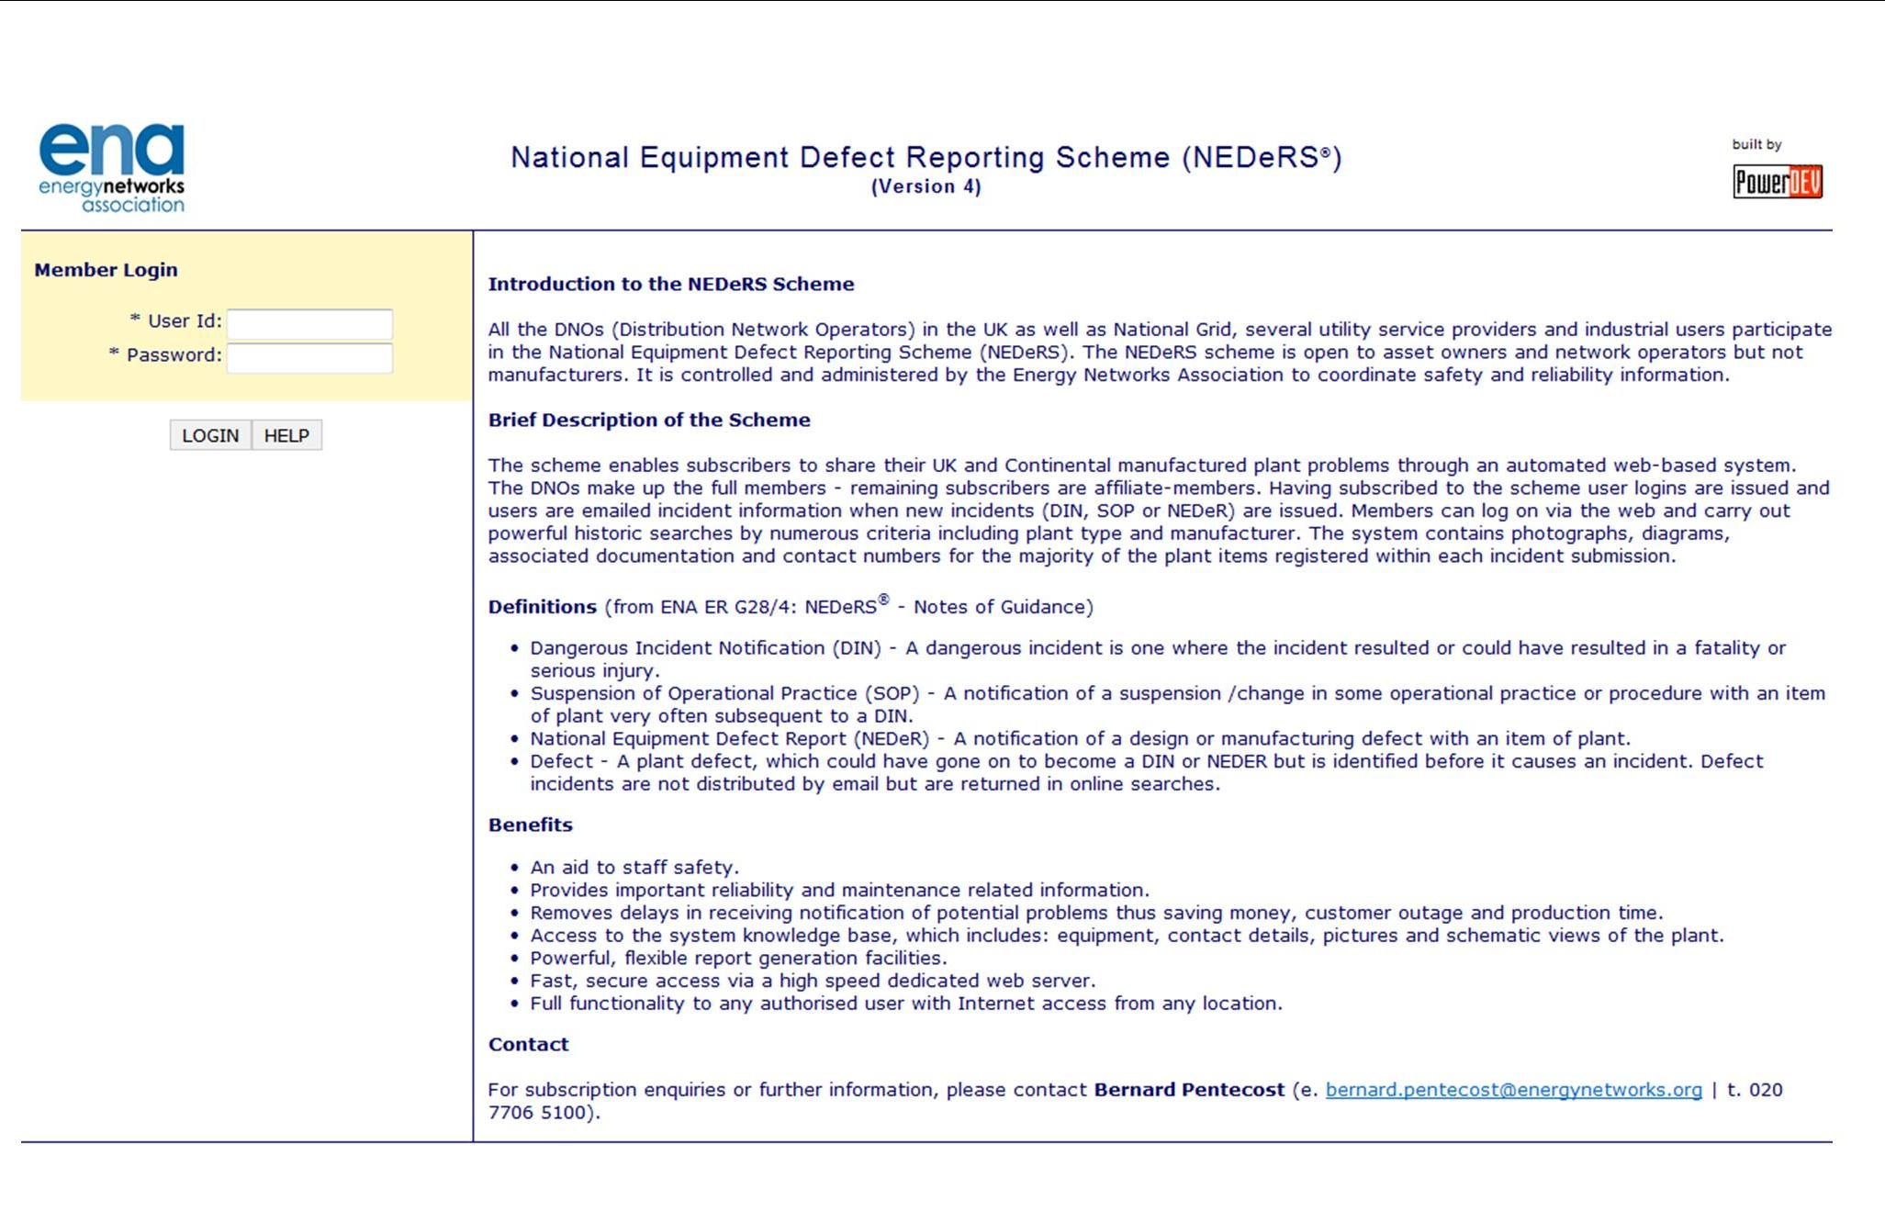

Log in Screen
Enter your User ID and Password here
Notes:
Copy of programme in delegate packs – thanks to the Gas Industry Safety Group for the conference bags. Infomation on the activities of the GISG is included – in particular the Gas Industry Safety Awards celebrating a decade of excellence which are to be held in November.
Programme covers safety, health and environment. HOWEVER unfortunately speakers from DEFRA and the Environment Agency who were due to speak have had to pull out due to the upcoming General Election.
Many thanks to Mike Clancy for stepping in at a few days notice to give one of the keynote presentations.

Slide 4
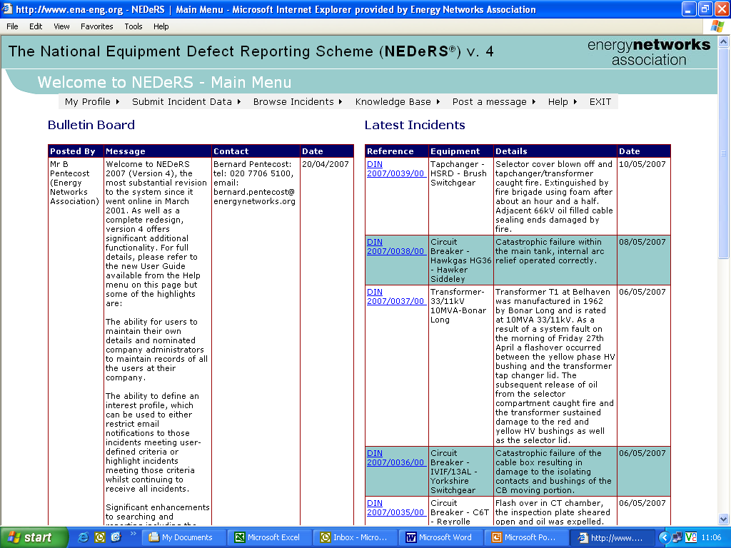
Entry Page
Drop down menu bar
Messages from NEDeRS admin or other Users
Details of the last incidents posted

Slide 5
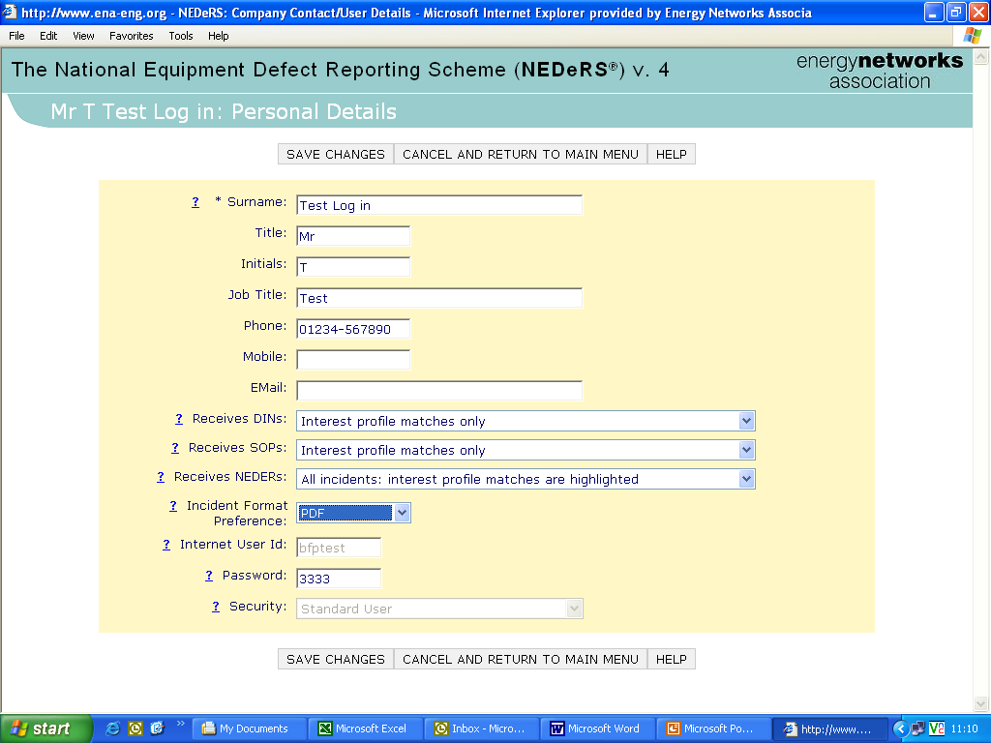
Profile Page
Update your own personal details

Slide 6
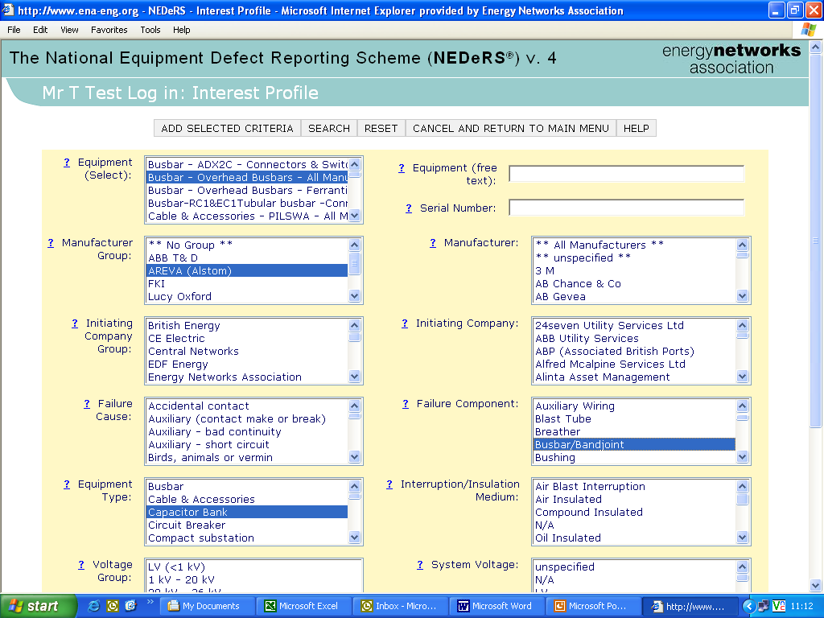
Interest Profile
Select what you want the scheme to notify you about

Slide 7
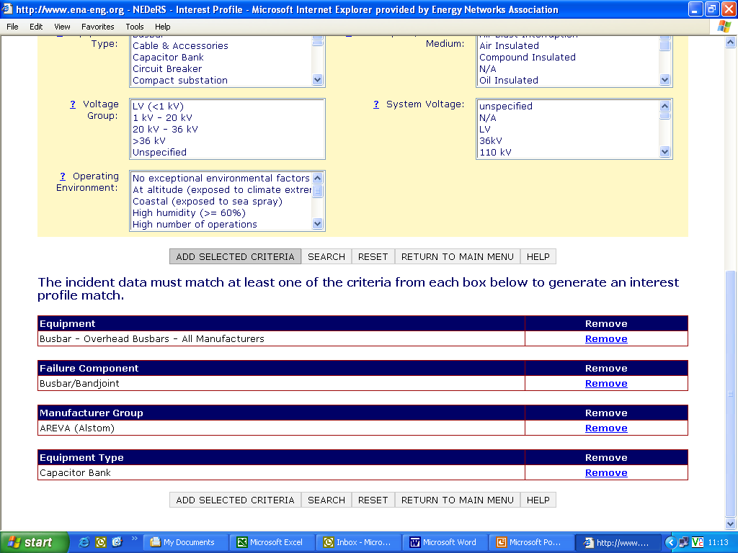
Interest Profile
Profile choices displayed for future reference
Remove criteria if your needs change

Slide 8
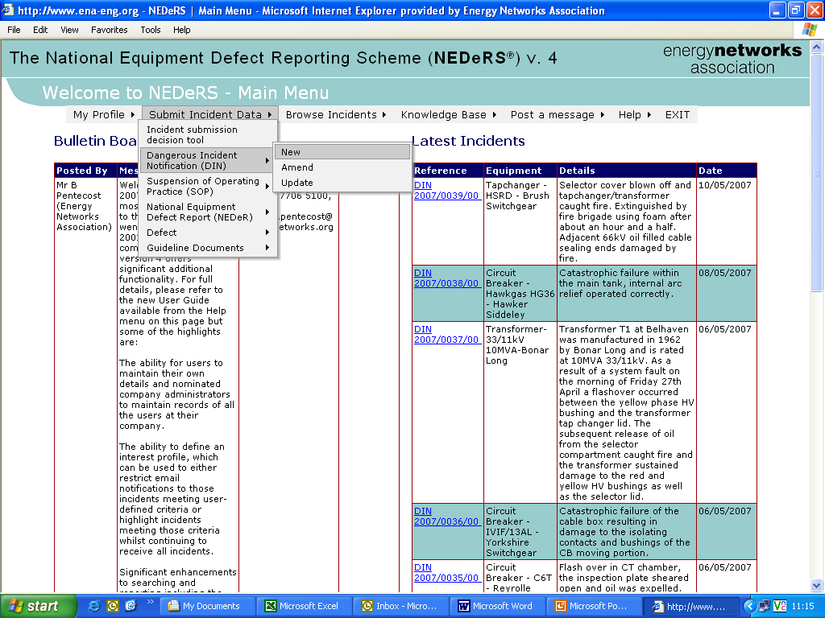
Entering Reports
Select your incident type using drop down menus

Slide 9
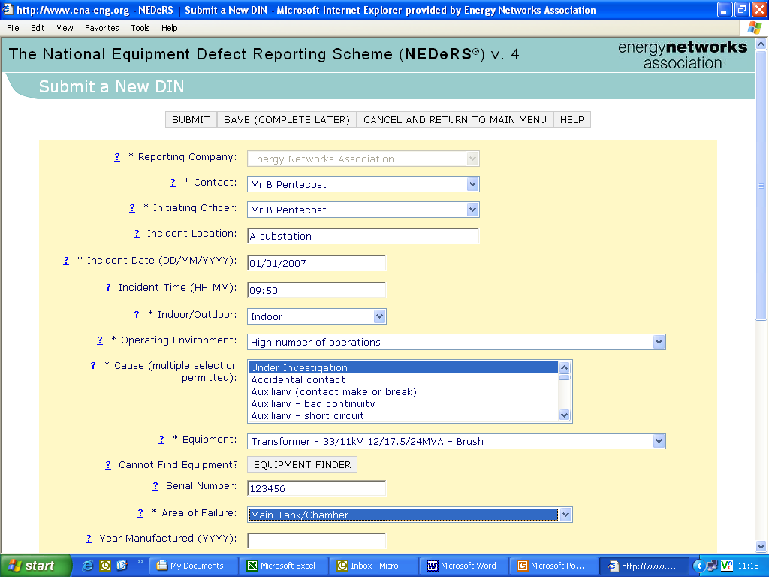
Entering Reports
Easy to use data entry sheets
Drop down menus for reporting consistency
Mandatory fields are marked *

Slide 10
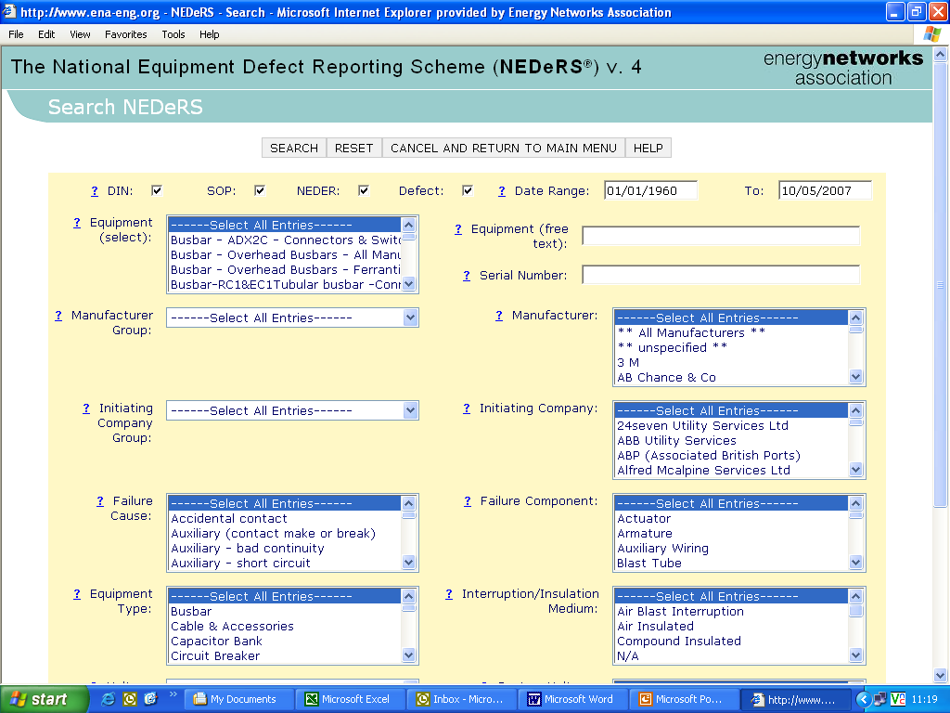
Search by details
Narrow your search using these criteria

Slide 11
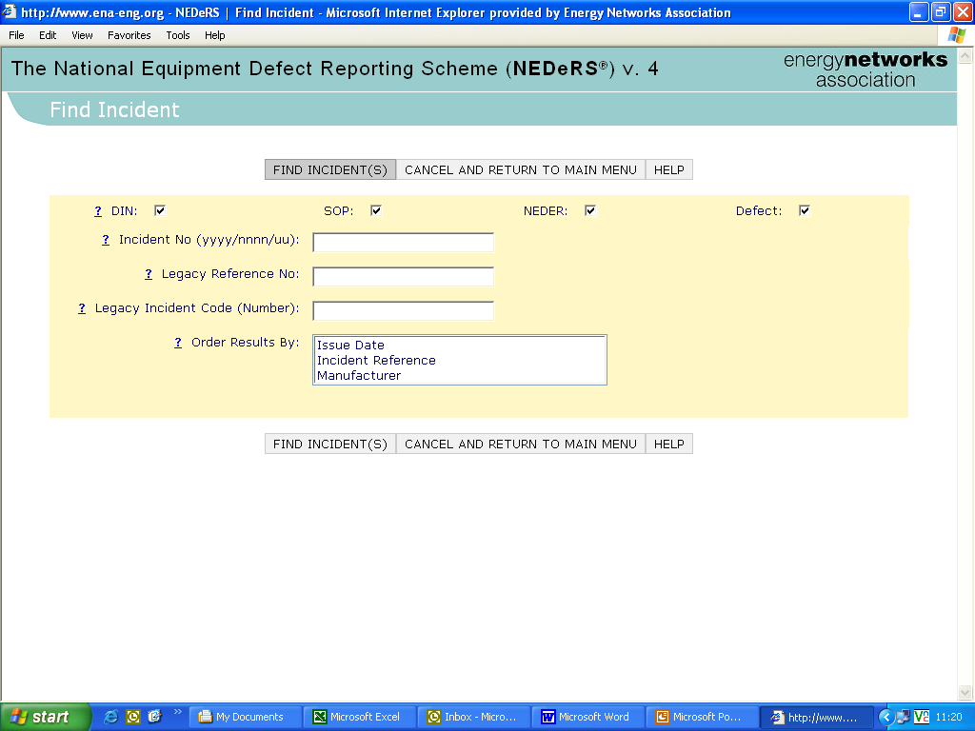
Search by Report Number
Use as many of these fields as you need

Slide 12
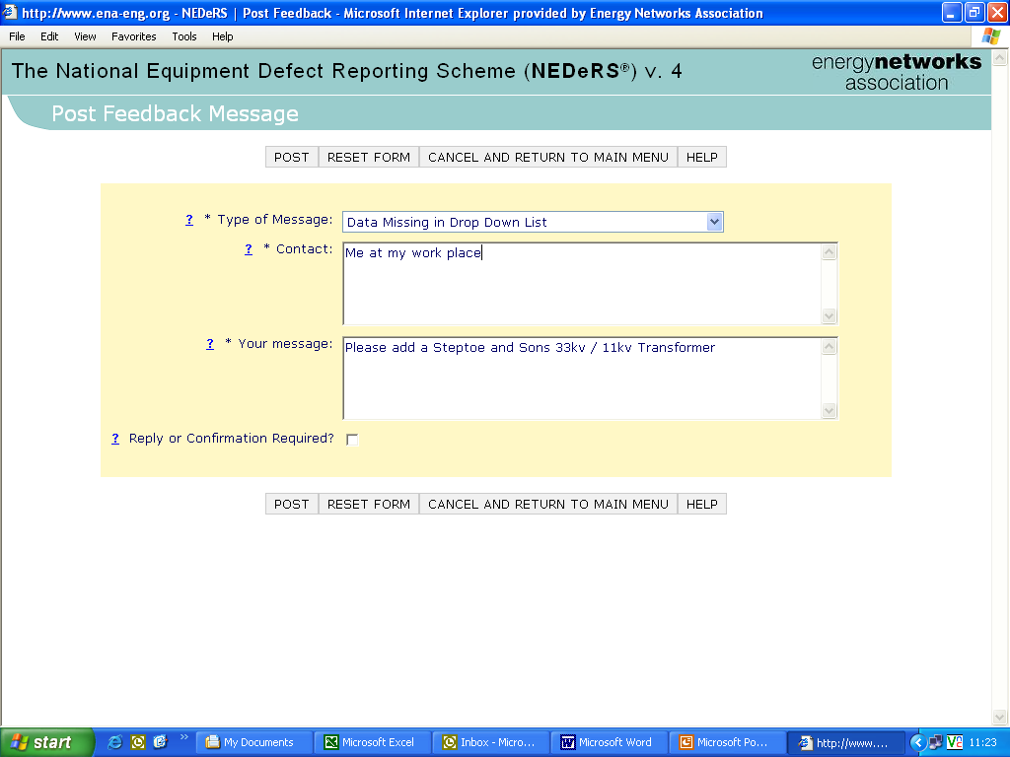
Post Feedback
Select what you need to tell us
Tell us who you are
What you would like us to do

Slide 13
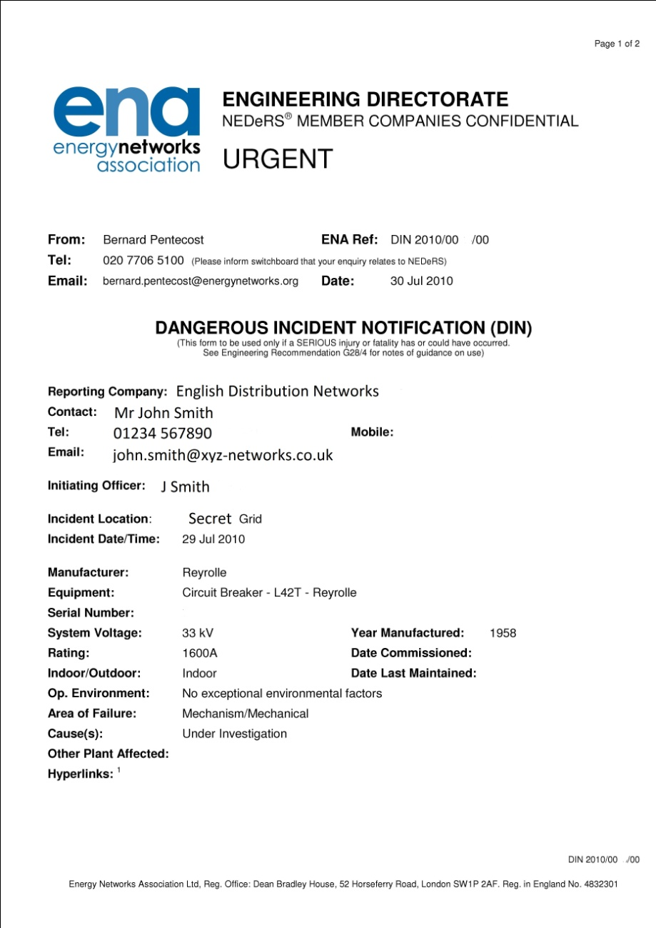
DIN Report

Slide 14
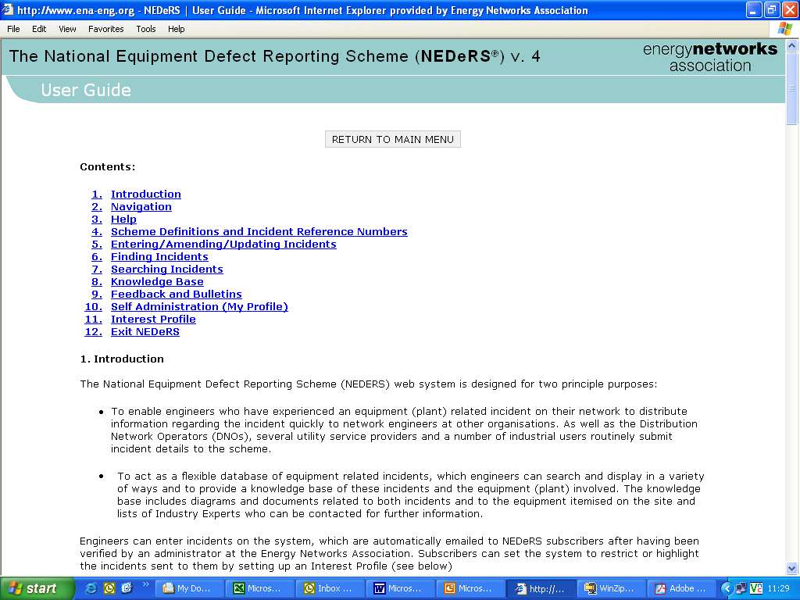
Help Menu and User Guide
Select a topic or scroll through

Slide 15
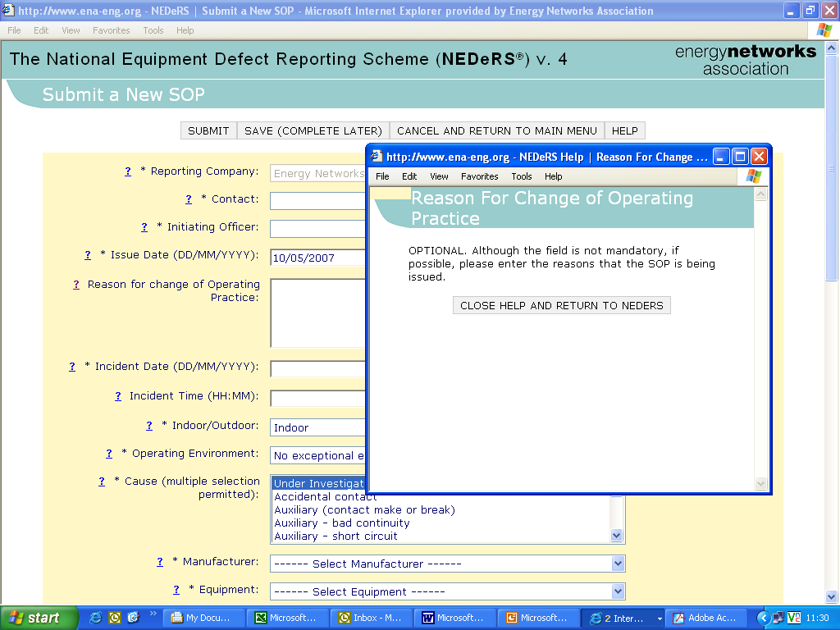
Online Help
Clicking on the Question mark
Brings up the specific help

Slide 16
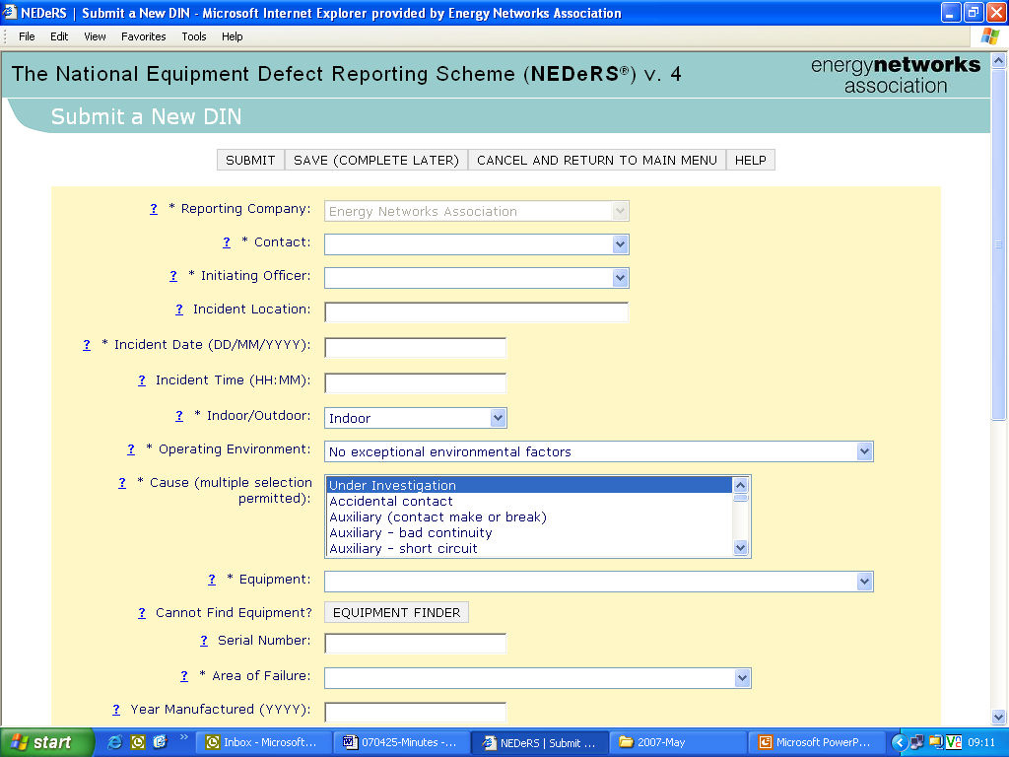
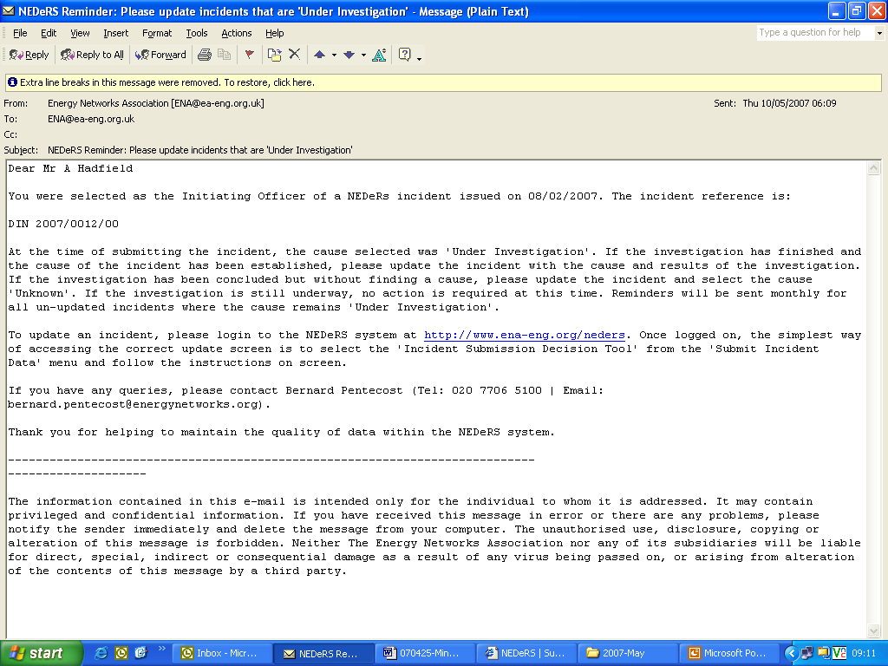
Reminders
If you use “Under Investigation” the system will send you a reminder to update the report.

Slide 17
For more information
Visit www.energynetworks.org and click on the “NEDeRS ®” link.
Contact NEDeRS ® Administrator at
  Energy Networks Association
  6th Floor, Dean Bradley House
  52 Horseferry Road
  London
  SW1P 2AF
  Tel: 020 7706 5100

